Slide 1



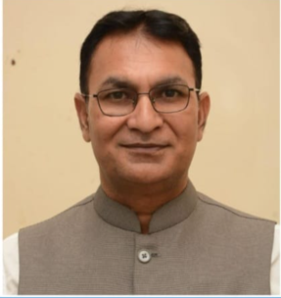
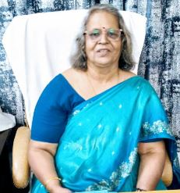
Celebration of 76th NCC Raising Day
“Invited Talk on Role of NCC in Cadets’ Personality Development”
Jointly Organized by-
Govt. Pt. Shyamacharan Shukla College, Dharsiwa, Raipur (C.G.),
8 CG Girls BN NCC, Raipur
23rd November 2024, Saturday
Prof. Rajeev Choudhary
Dean, Students’ Welfare,
Head, SoS Law, Prof. Physical Education
Pt. Ravishankar Shukla University, Raipur
Patron
Dr. Pushpa Kaushik
Principal
Govt. Pt. Shyamacharan Shukla College, Dharsiwa
Venue-
Seminar Hall
10:30 AM Onwards
Co-ordinator
Capt (Dr.) Sushama Mishra
Asst. Prof. & ANO

